Slide 1
Right heart catheterization
Dr K V Patil

Slide 2
Indications
Evaluation or diagnosis of pulmonary hypertension
Distinduishing etiology of shock based on mixed venous oxygen saturation (SvO2) measurement such as in septic or cardiogenic shock
Assessment of volume status in severe shock
Evaluation of pericardial illnesses such as cardiac tamponade or constricitve pericarditis
Assessment of right-sided valvular disease, congenital heart disease, cardiac shunts, when surgical repair is planned

Slide 3
Contraindications
Insertion of the catheter through a site where is an active infection
Presence of a Right sided ventricular assist device

Slide 4
Swan-Ganz catheter - catheter of choice for the internal jugular approach
Pulmonary hypertension Swan for the femoral approach and for patients with pulmonary hypertension or severe tricuspid valve regurgitation (TR) - it is stiffer and more torquable.
End-hole catheters, or “balloon wedge catheters,” similar rigidity, less catheter whip artifact and thus higher fidelity - lack the capacity to determine cardiac output by thermodilution.

Slide 5
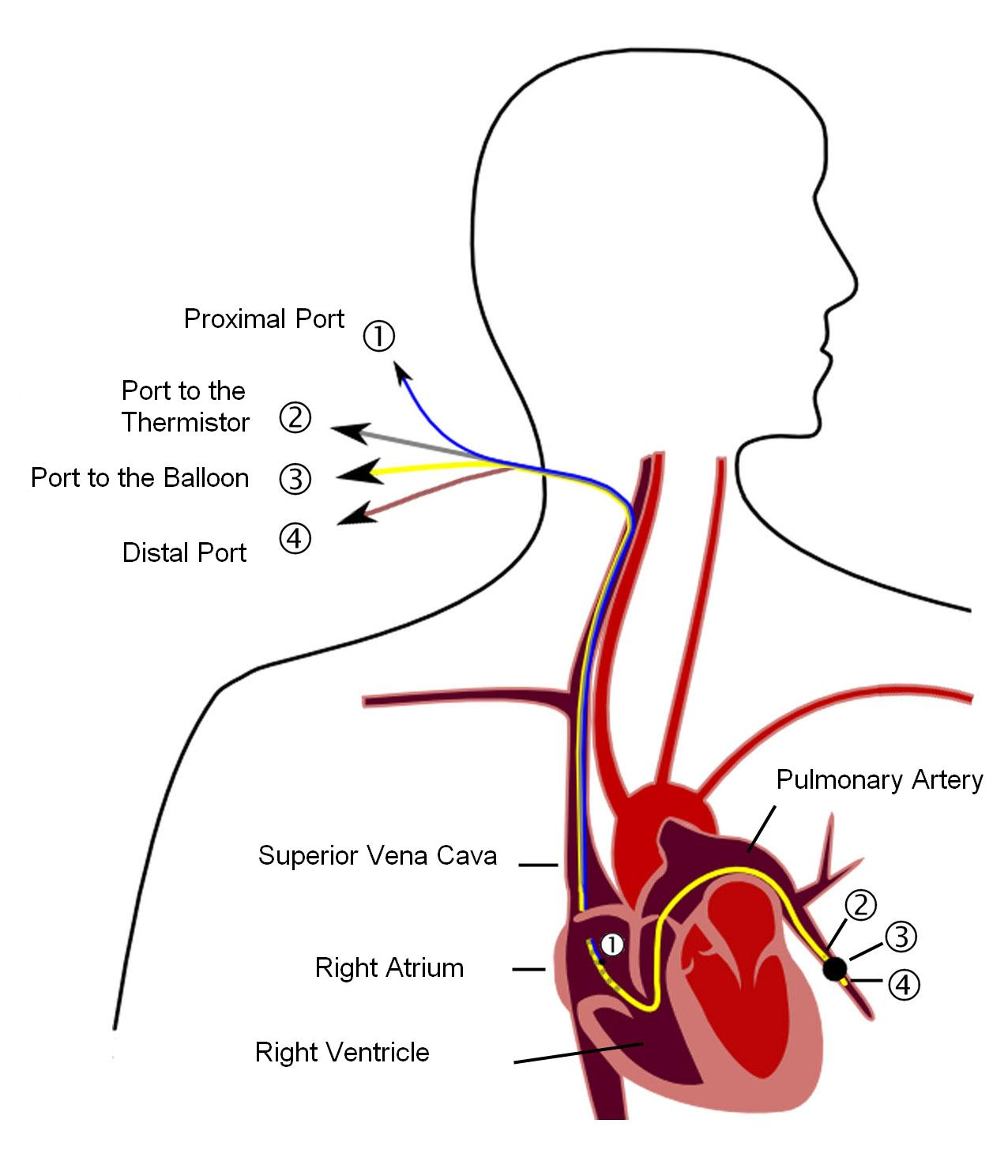
Swan-Ganz balloon flotation catheter
4 ports
  blue port: distal tip of the catheter
    obtains pressures as the catheter is advanced through the right-sided chambers (RA-PA-PCWP)
  dark gray port: lumen 30 cm proximal to the tip; when the catheter tip is in the PA, dark gray port opening is in the RA
    used to inject saline in the RA and obtain CO by thermodilution technique
    may be used to record RA pressure simultaneously to PA pressure

Slide 6
balloon port: distal balloon and allows wedging of the catheter tip (PA pressure → PCWP)
temperature sensor port: communicates with the distal catheter tip;
  after cold saline is injected through the dark gray port (RA), the distal sensor (PA) allows analysis of the temperature change over time and calculation of CO

Slide 7
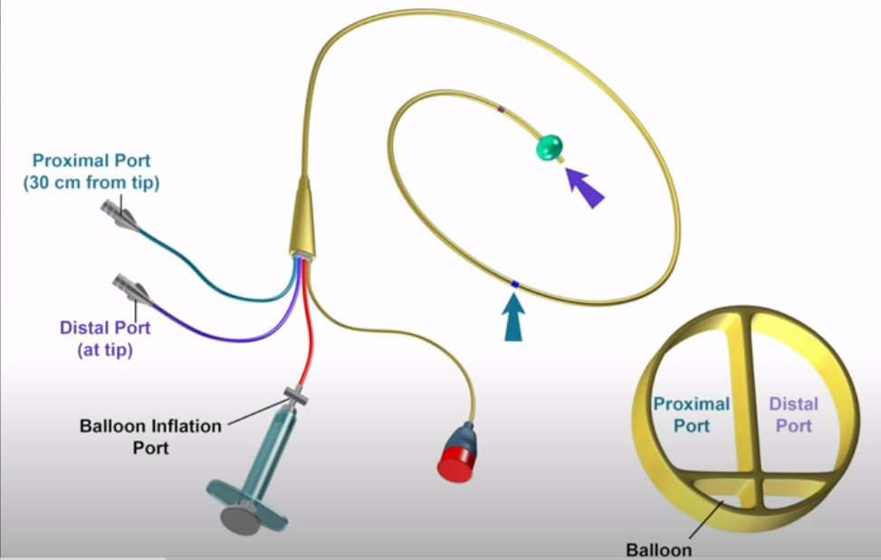
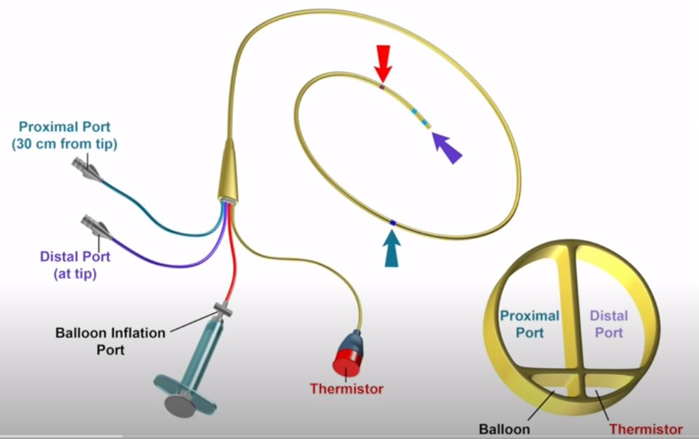

Slide 8
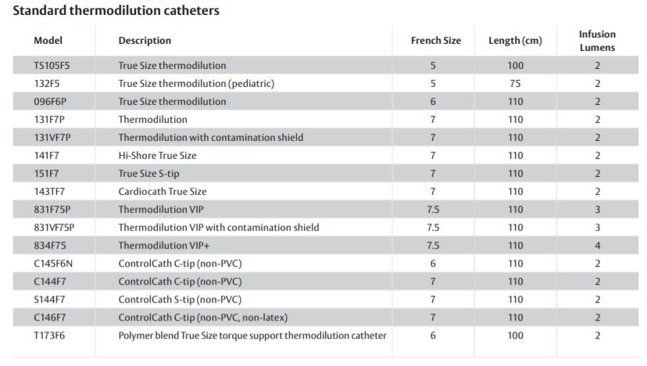
Edwards lifesciences

Slide 9
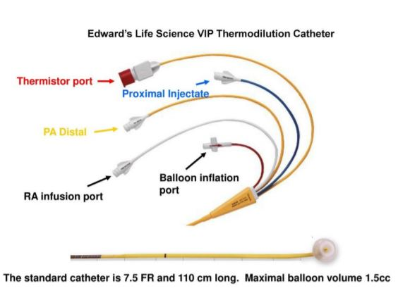

Slide 10
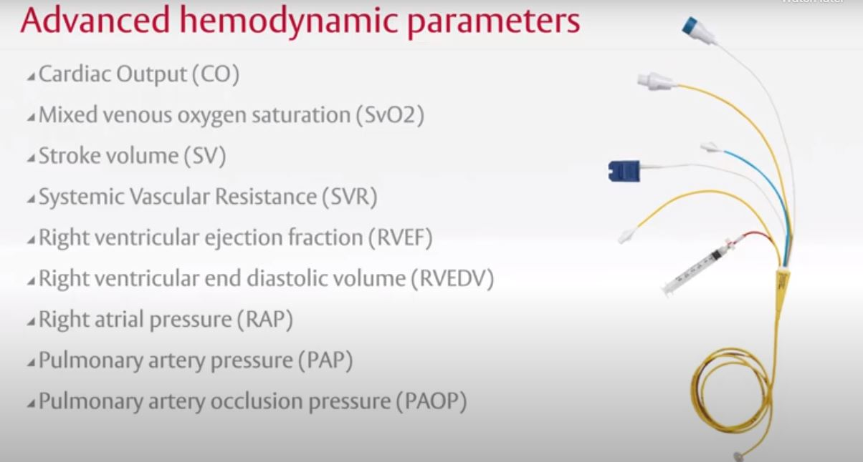

Slide 11
Pul vascular resistance
  Q = P / R
Right ventriculography
  right-to-left ventricular shunts
  TR
  RV dysplasia
  abnormalities of the RV outflow tract (RVOT)
  pulmonary stenosis

Slide 12
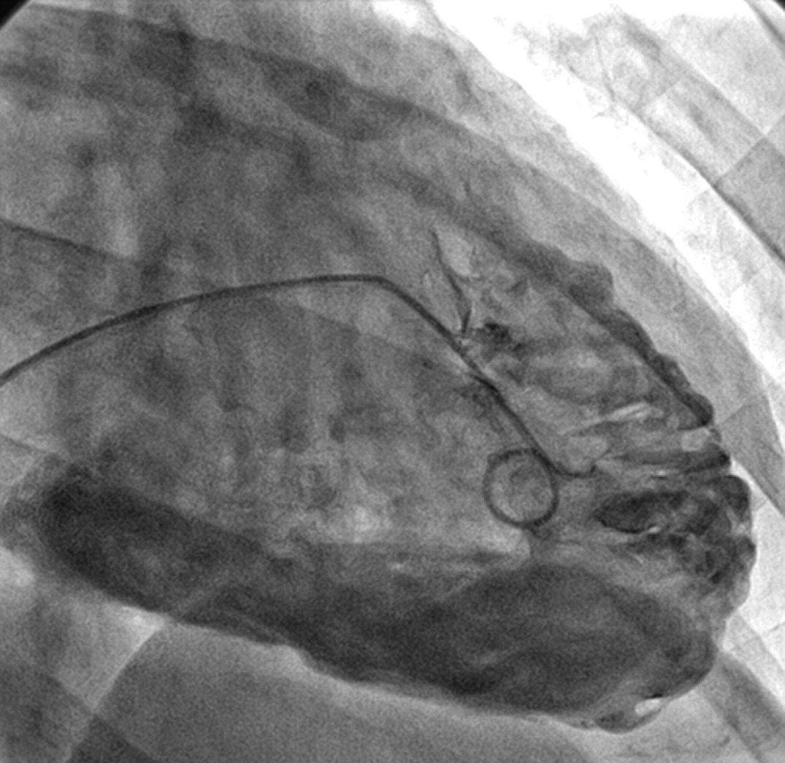

Slide 13
7F Berman balloon-tipped catheter is used, which has no end hole but eight side holes proximal to the balloon.
AP lateral projection is used to visualize the septum and RVOT
Typically, 20 to 30 mL of contrast material is injected at 8 to 10 mL/sec (but if enlarged, could be up to 40 to 50 mL at 12 to 18 mL/sec)

Slide 14
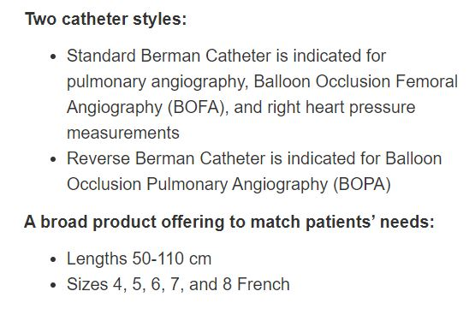
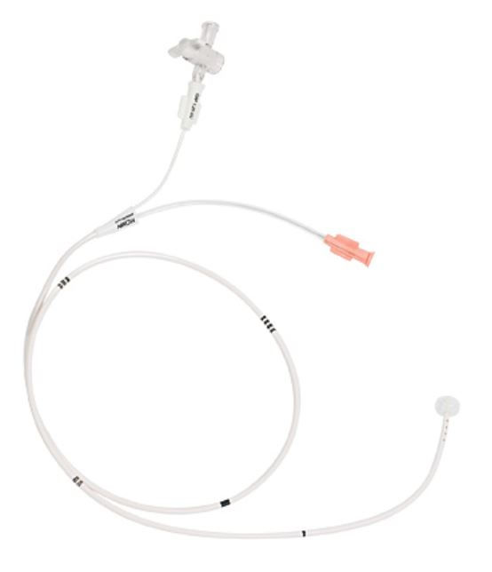
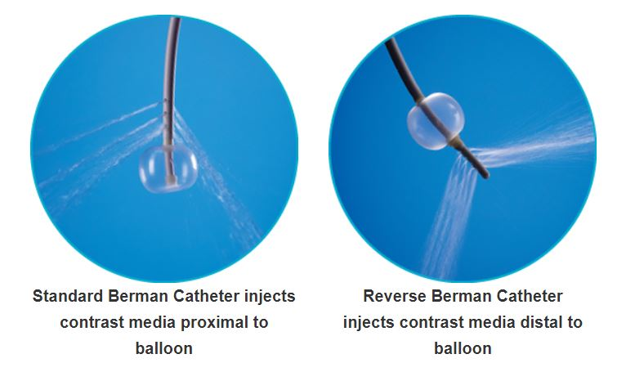
Berman catheter
Source – Teleflex incorporated

Slide 15
Artifacts/Errors
Damping
  Kink, high viscosity fluid(contrast), thrombus, tip hitting chamber wall
Whip artifact
  tapping on any of the connected catheter-tubing system elements
Impact artifact
  catheter is struck by the walls or valves of the cardiac chambers
End pressure artifact
  streaming or high velocity of the pressure wave when using an end-hole catheter

Slide 16
Micromanometer Catheter
pressure transducer mounted at the tip
eliminates the interposing fluid column and its damping effect as well as the 30- to 40-millisecond delay
waveform is less distorted and the whip (motion) artifact is greatly reduced
3.5F Mikro-Cath, Millar

Slide 17
Two transducers separated by a short distance allow for accurate determination of gradients within chambers (e.g., intraventricular gradient in HCM) and across structures (e.g., stenotic aortic valve)
Some micromanometer systems allow for over-the-wire insertion and angiography

Slide 18
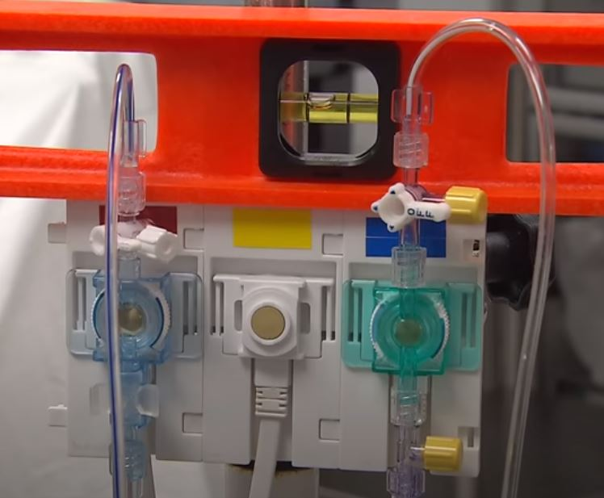
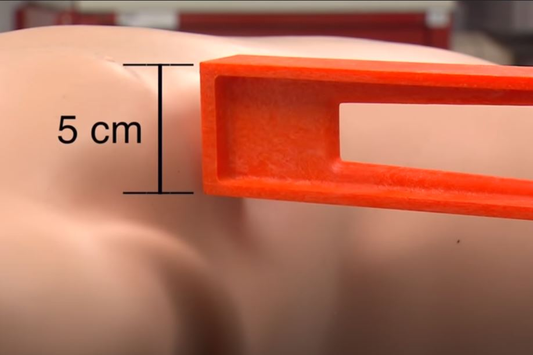
Procedure
Below sternal angle
Transducer position at level of RA

Slide 19
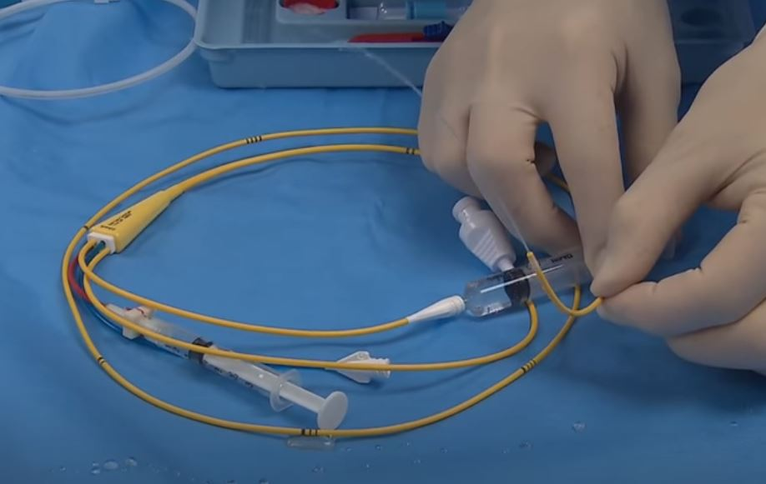
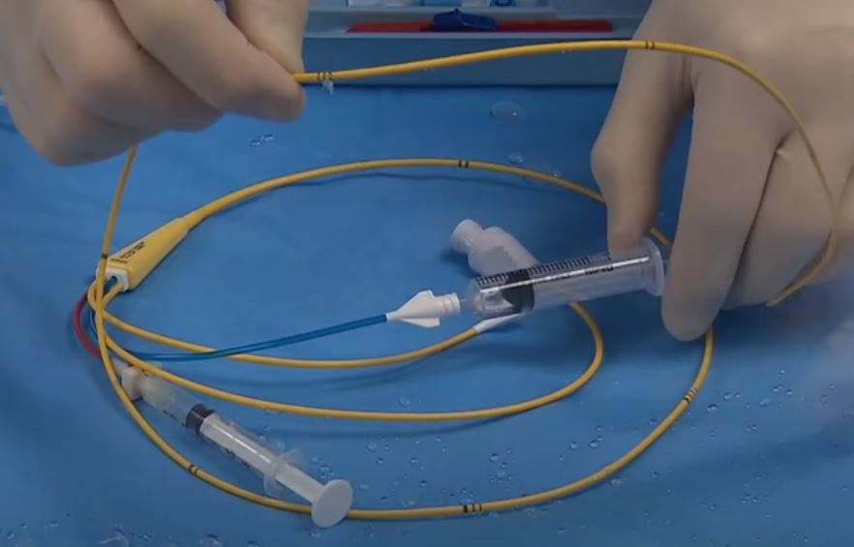
Prox and distal lumens primed with saline

Slide 20
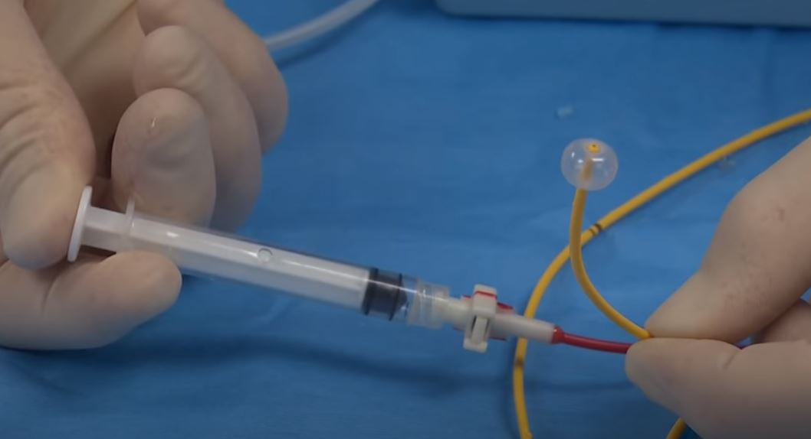
Integrity of balloon checked
Catheter markings: thick @ 15cm, thin @ 10 cm

Slide 21
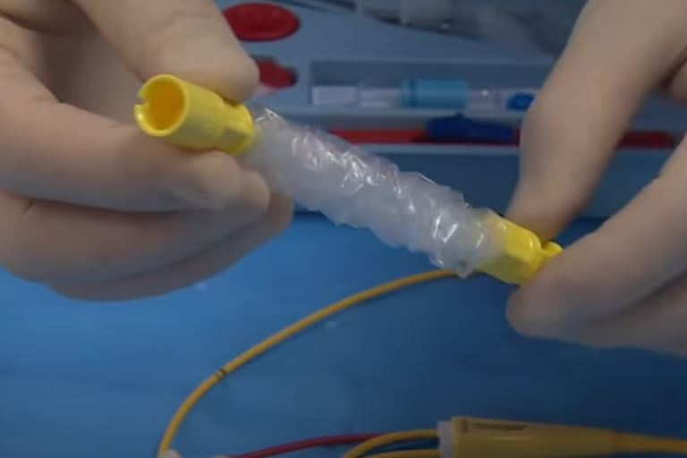
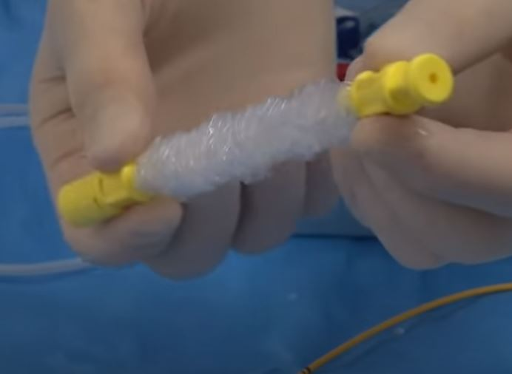
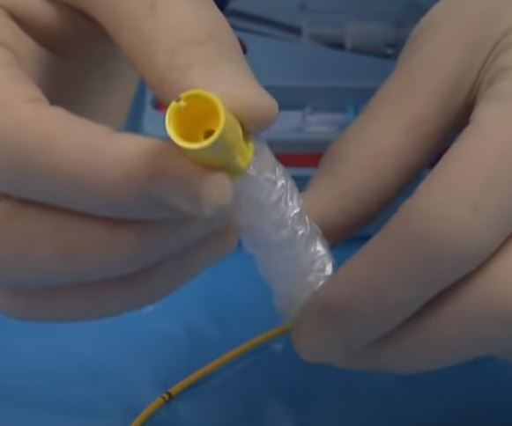
Sterile sheath if catheter is to remain for longer time

Slide 22
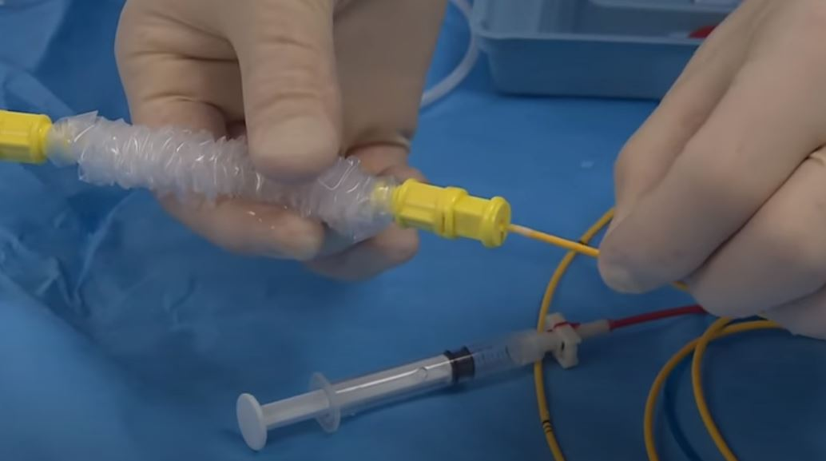
Catheter inserted into sheath prior to catheter placement

Slide 23
Percutaneous venous access is accomplished via the internal jugular vein or femoral vein or less frequently the subclavian or antecubital vein
Right heart catheter is advanced to the RA
catheter is connected to the pressure transducer and flushed; RA pressure is recorded after ensuring proper zeroing at the mid-chest level

Slide 24
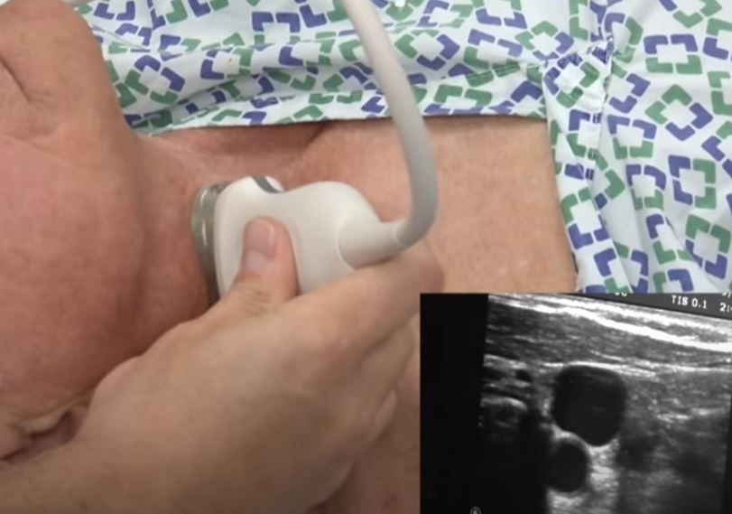
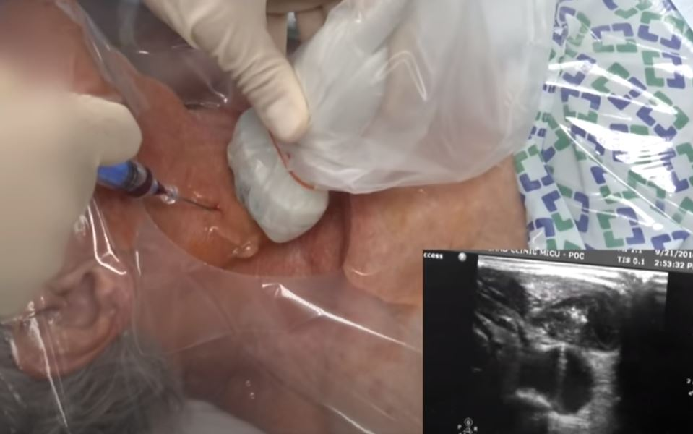
IJV identified with USG
Sterile precautions – LA - IJV punctured

Slide 25
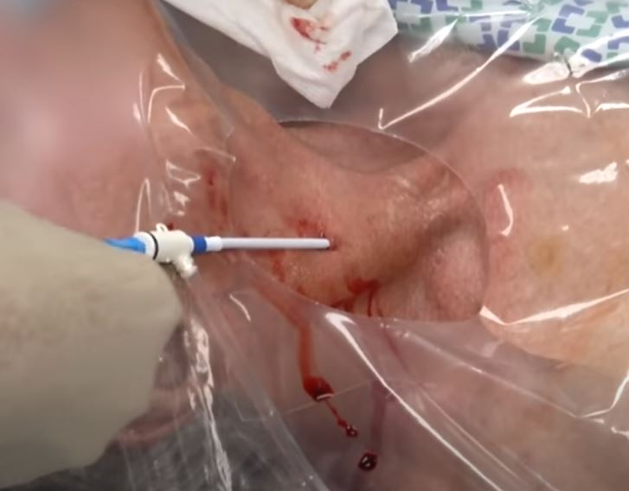
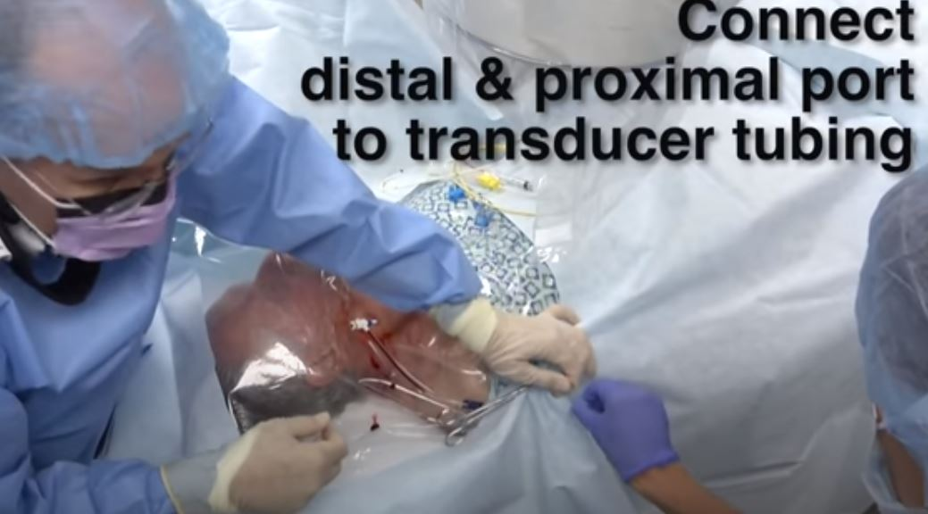
8.5F introducer sheath inserted

Slide 26
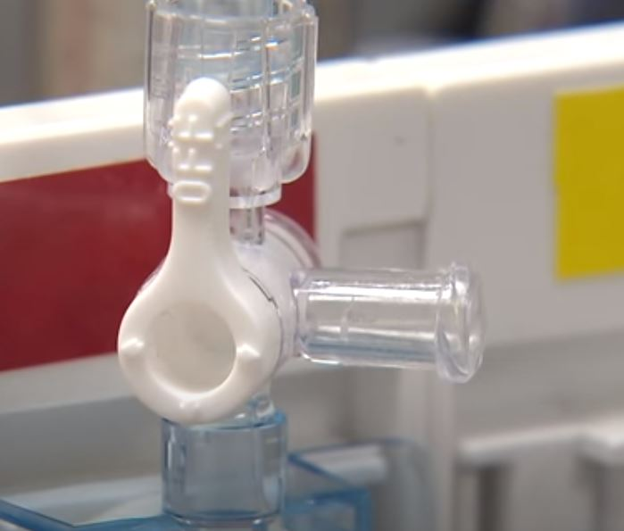
Transducer zeroed by opening it to air -> Valve closed so that the transducer is opened to catheter

Slide 27
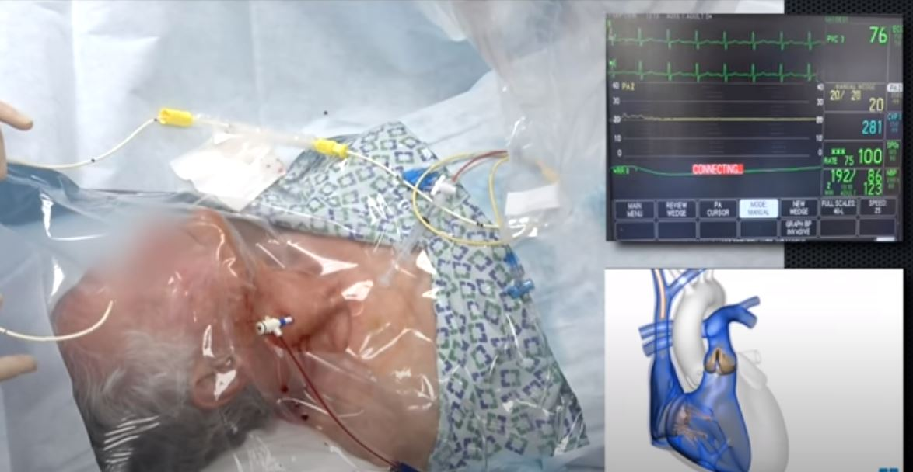
Catheter is inserted for 20 cms – tip at RA

Slide 28
catheter is then advanced to the RV then the PA while the balloon at the tip of the catheter is inflated and pressures are recorded
fluoroscopy is advisable, especially if there are any preknown structural and functional difficulties (e.g., severe right atrial enlargement, severe TR, severe right ventricular dilation).

Slide 29
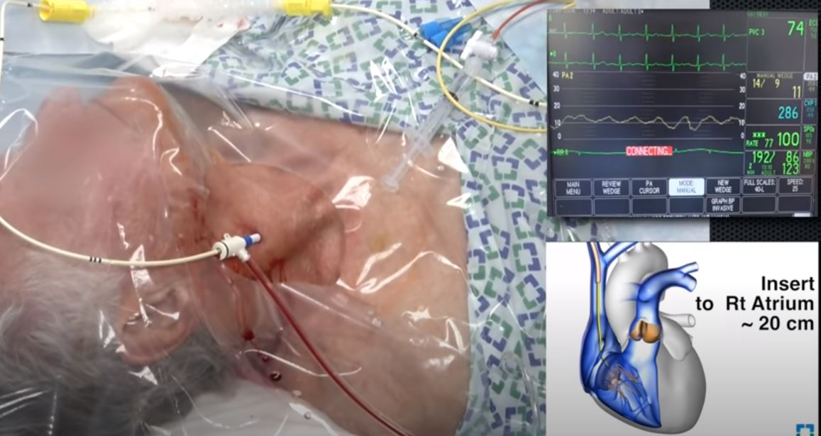

Slide 30
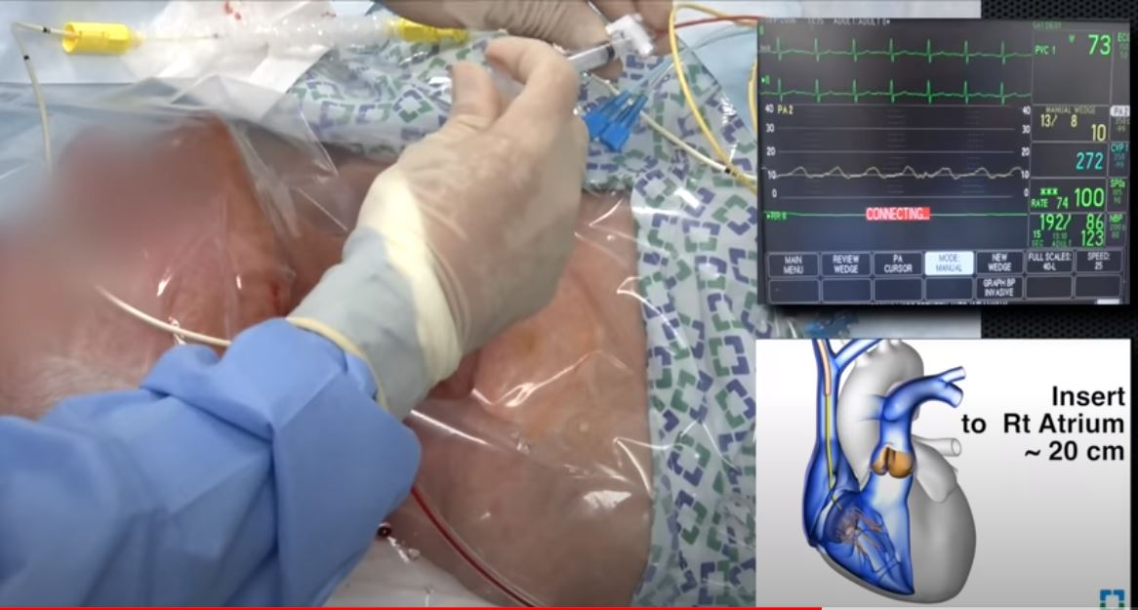
Balloon inflated with 1.5 cc syringe

Slide 31
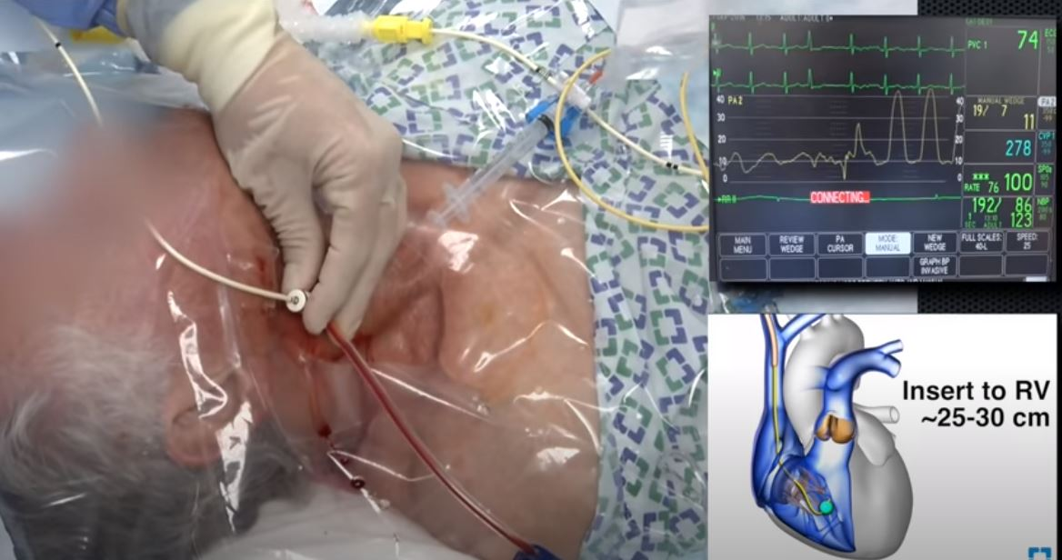

Slide 32
Femoral route needs special handling
  At the base of the RV inflow (diaphragm level), catheter is torqued clockwise with a slight pull until it points superiorly and falls into the PA
  Deep inspiration and cough may assist in crossing the pulmonic valve and advancing the catheter distally
  Alternatively catheter tip may be “hooked” in the hepatic vein or directed towards the lateral RA and then advanced, creating a loop in the RA → balloon inflation and further catheter push direct the tip of the loop towards the RV

Slide 33
Swan wire may be used to assist in advancing the catheter- provides stiffness
  use caution to prevent perforation of the pulmonary artery

Slide 35
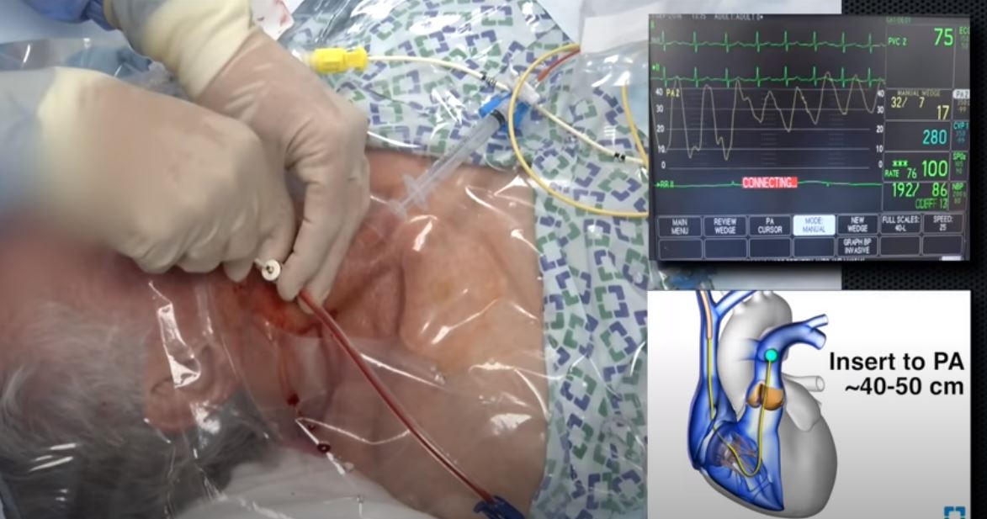

Slide 36
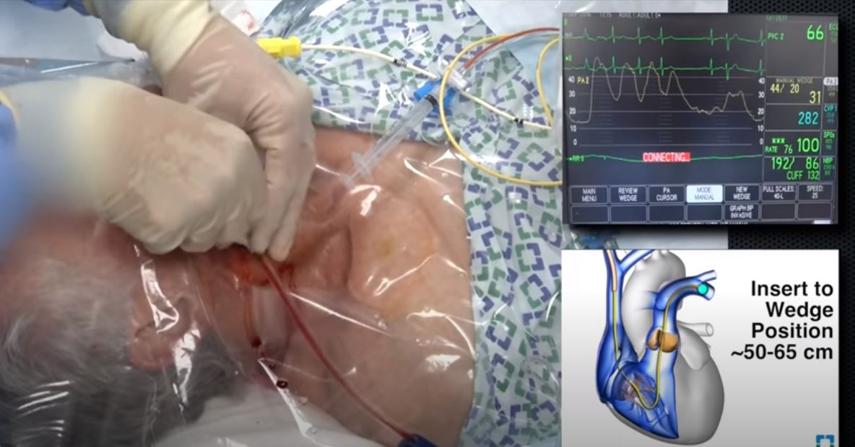

Slide 37
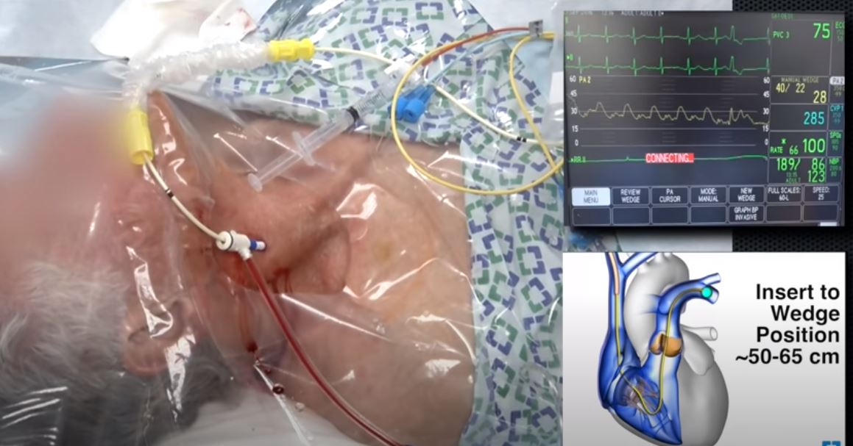
Balloon deflated

Slide 38
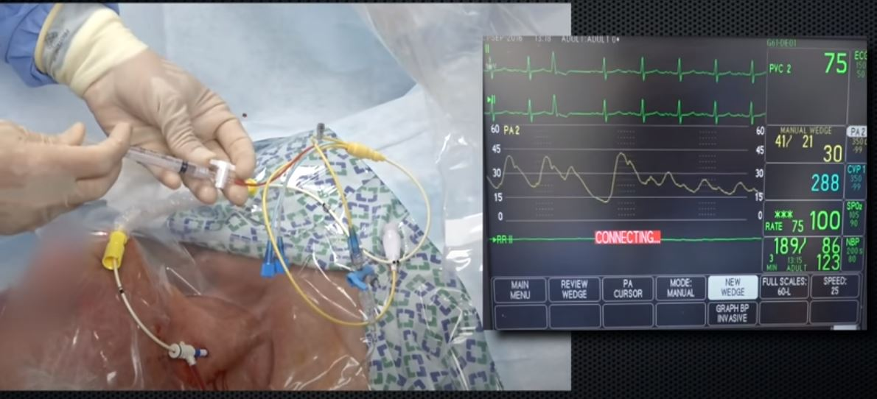
Wedge measurement
Gradual inflation till satisfactory waveform is obtained

Slide 39
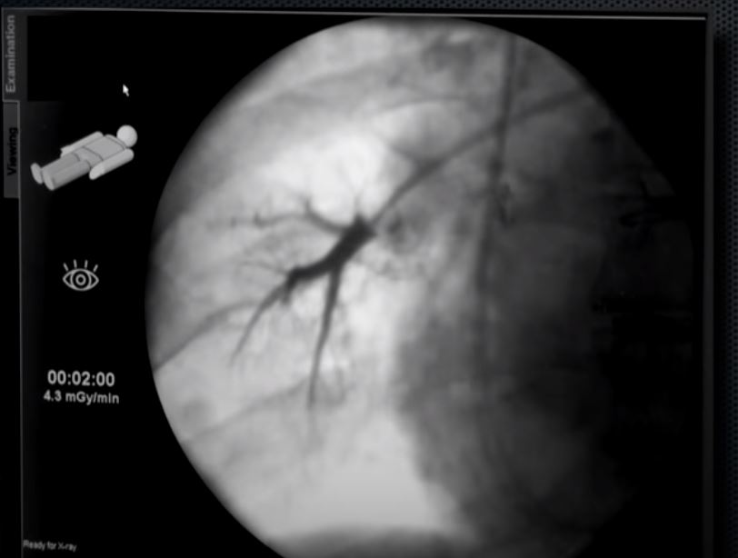
Once the balloon is inflated a static column of blood exists between pul A distal to balloon and similar sized post capillary veins

Slide 40
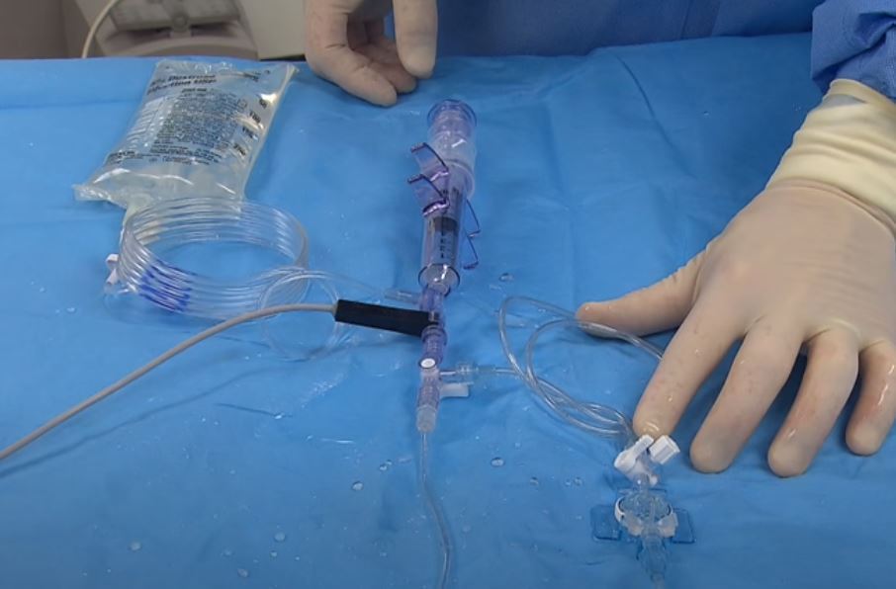
Cardiac output - thermodilution
Room temp or cold solution for injection at proximal port of catheter
Syringe
Stop cock
Temp probe for measuring ambient temp of soln – connected to monitor interface
Tubings for injecting solution

Slide 41
Appropriate conversion factor is entered into the system – provided by catheter supplier
Exactly 10cc soln drawn into the syringe
Injected with rapid and steady rate

Slide 42
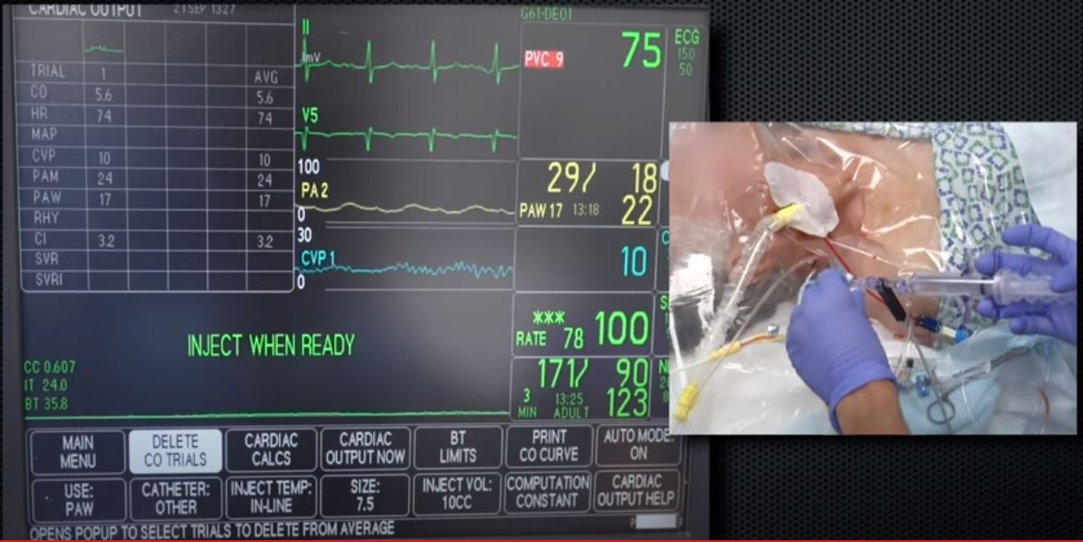

Slide 43
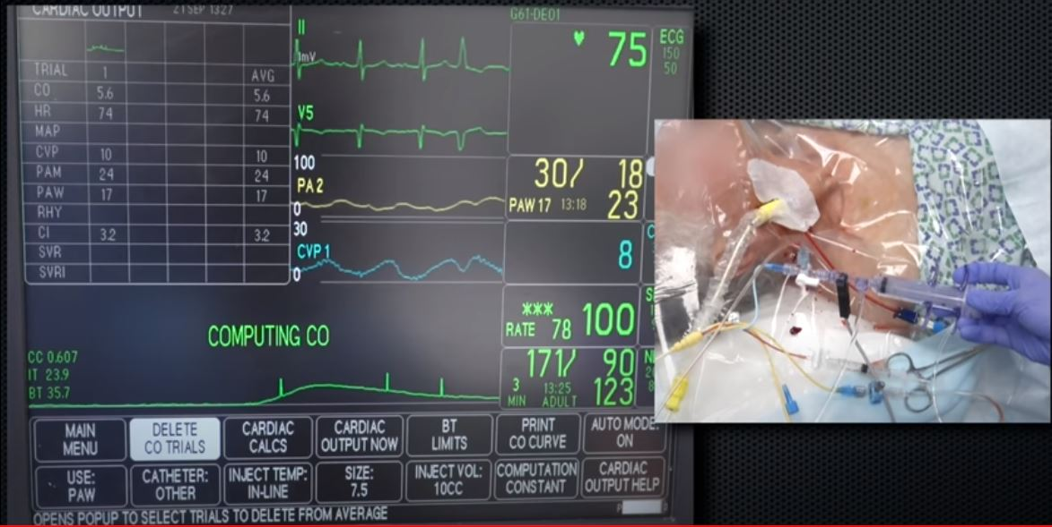
Monitor indicates change in temp and software calculates area under the curve
Larger the area lower the CO
Minimum 3 CO measurements taken and averaged

Slide 44
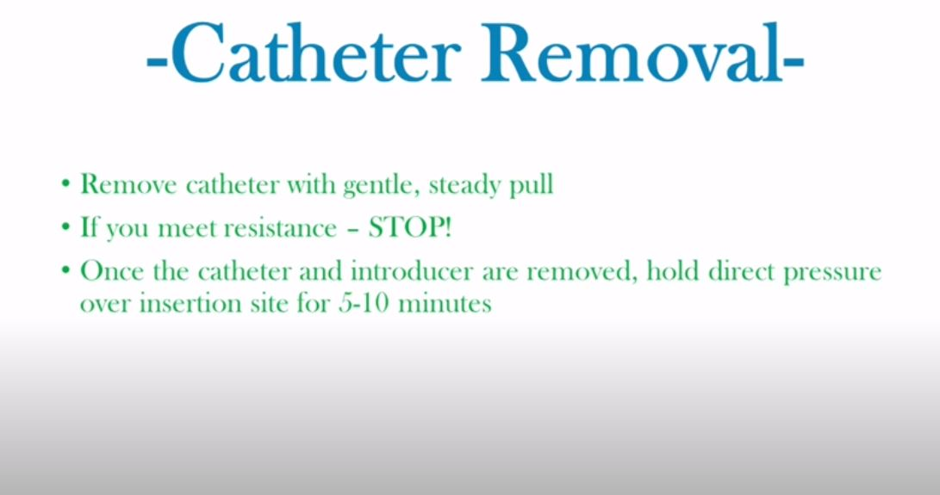

Slide 45
Complications
Arrhythmias
Misplacement
Knotting
Myocardial, vessel, or valve rupture
Pulmonary artery perforation
Pulmonary infarction
Thromboembolism
Infection
Air embolism

Slide 46
    HEMODYNAMICS

Slide 49
RA tracing
Characterized by A, C and V waves and X and Y descents (A-X-V-Y sequence)
  A wave - atrial contraction and follows electrocardiographic P wave, by ~ 80ms
  X descent - pressure dip that occurs during early ventricular systole - corresponds to the atrial relaxation and to the descent of the tricuspid annulus in early systole
  C wave – interrupts X descent due to protrusion of the closed tricuspid valve into the right atrium with RV contraction
    splits X into atrial relaxation (X) and annular descent (X').

Slide 50
  V wave - atrial filling during ventricular systole while the tricuspid valve is closed
    follows the R wave on the ECG, peaks at or after the end of T wave and almost intersects with the ventricular pressure descent
    under normal conditions, RA v wave is smaller than a wave
  Y descent - occurs in early diastole as the tricuspid valve opens and the RA rapidly empties

Slide 51
(coincide with the pulse)

Slide 52
Inhalation leads to a drop in intrathoracic and right atrial pressure, and exhalation has the opposite effect
Reverse is true for patients on mechanical ventilation
Pressures are best measured at end expiration

Slide 53
atrial pressure,
A wave follows
the P wave, and the V wave
peaks at or after the end of the
T wave and almost intersects
with the ventricular pressure
Descent
ventricular pressure
increases in diastole
and has an A wave, as opposed
to the arterial pressure
that decreases in diastole,
has no A wave, and has a
dicrotic notch

Slide 54
Correlations between the RA pressure tracing and the Doppler tracings of IVC, hepatic veins and transtricuspid flow
X and Y descents “suck” flow from the venous system - forward venous flow
  X descent - forward systolic S wave
  Y descent – forward diastolic D wave on the IVC/hepatic venous Doppler
A and V ascents attenuate forward venous flow and may reverse it
  A wave - atrial A reversal on the hepatic vein/IVC Doppler tracing
  V wave - late part of the S wave
S wave may be notched and divided into S1 and S2 as a result of the C wave

Slide 56
Gradient between the V wave and the early ventricular diastolic pressure corresponds to the E flow
Late RA-RV diastolic gradient during atrial contraction (A wave) corresponds to the A flow

Slide 57
Abnormalities
Deep X and deep Y descents
  loss of atrial and ventricular compliances
  constrictive pericarditis and restrictive cardiomyopathy
Deep Y
  acute or subacute RV failure or severe TR

Slide 58
Prominent V wave
  V wave larger than 1.5 times mean RA pressure or V wave larger than mean RA pressure by greater than 5 mmHg
  correlates inversely with atrial compliance
  severe TR, decompensated RV failure with RA volume overload

Slide 59
Ventricularization of the RA pressure - specific for severe TR
    V wave may enlarge and widen to a point that it simulates the RV systolic pressure contour and peaks during ST/T segment rather than after the T wave (so-called large C-V wave)
    large RA V wave increases in inspiration

Slide 60
Deep X (systole) but shallow Y (diastole)
  Tamponade
  pericardial pressure is elevated (usually 15–30 mmHg) and compresses all cardiac chambers in diastole until the diastolic pressure of these chambers equalizes with the pericardial pressure
  annulus moves down in early systole, the pressure that built up in the RA suddenly drops, leading to a deep X descent

Slide 61
prominent A wave
  reduced ventricular compliance
    (Remember!!! A wave correlates inversely with RV compliance, whereas the V wave correlates inversely with RA compliance)
  RV hypertrophy, pulmonic stenosis
Elevated A and V waves
  large ASD
In the absence of tricuspid stenosis or regurgitation, mean RA pressure ~ mean RV diastolic pressure
  An elevated RA pressure defines RV failure

Slide 62
Sinus tachycardia
  shortens diastole and attenuates Y descent
  may make A and V waves appear to merge – only one positive and one negative waves may be identified
AF
  A wave is absent and V wave becomes prominent; the tracing mostly consists of one wave (V) and one descent (Y), but C and X' may be seen

Slide 63
RV and PA tracing
Arterial vs ventricular tracings - noted while advancing the right heart catheter
  ventricular pressure increases in diastole, whereas arterial pressure decreases in diastole
  ventricular pressure tracing in systole has a “rectangular” shape, as opposed to the “triangular” shape of arterial tracings
  ventricular pressure has an A wave in diastole
  arterial pressure has a dicrotic notch.

Slide 64
PA systolic pressure = RV systolic pressure, and PA diastolic pressure = PCWP > RV EDP = RA pressure
Right atrial pressure and PCWP may be equal in cases of tamponade, constrictive pericarditis and severe RV failure

Slide 65
RV failure
RV diastolic pressure is equal to RA diastolic pressure during most of diastole except early part
normally an RV pressure dip in early diastole that sucks blood from the RA
high early RA-RV pressure gradient
  young individuals who have a potent RV relaxation (“suckers”)
  decompensated right HF who characteristically have elevated RA pressure that pushes blood in the RV (“pushers”)

Slide 66
  Loss of RV compliance makes the RV diastolic pressure rise rapidly to a high-level plateau, - early RV diastolic dip followed by a “plateaued” high diastolic pressure
    Dip and plateau pattern
As a result of prolonged diastasis, a pattern similar to dip-plateau pattern may be seen with bradycardia.

Slide 67
Deep early diastolic dip (lower arrows) followed by a plateaued elevated diastolic pressure (~20 mmHg)
Pulsus alterans
severe biventricular failure, with RV dilatation and severe TR

Slide 69
PCWP
Represents a slightly damped and delayed reflection of the left atrial pressure waveform, c waves may not be seen
V wave is larger than the A wave
smoother contour with less deep X and Y descents than LA pressure
mean PCWP (especially large V wave) is commonly used to address the risk of pulmonary edema and should be reported in each study
Mean PCWP = mean LA pressure
Delayed approximately by 50 to 150 milliseconds

Slide 71
normal mean PCWP 12 mmHg or less
chronic HF - values up to 15 to 18 mmHg may not lead to congestion due to increased pulmonary capillary lymphatic drainage

Slide 72
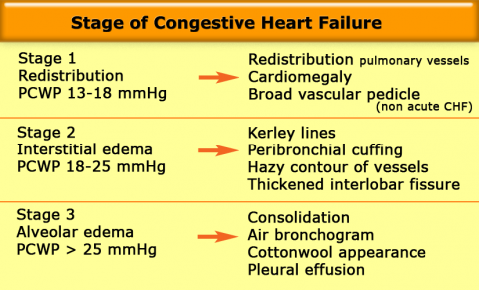

Slide 73
Interpretation and Pitfalls
mean PCWP is equal to or is up to 5 mmHg lower than diastolic PA pressure, to allow blood to flow forward through the pulmonary capillaries
pulmonary venous hypertension related to left HF (postcapillary pulmonary hypertension) - PCWP ~ diastolic PA pressure
pulmonary arterial hypertension related to arterial and arteriolar remodeling (post capillary)- PCWP is lower than diastolic PA pressure by more than 5 mmHg.

Slide 74
Mean PCWP greater than diastolic PA
  Severely decompensated MR with gigantic V wave - blood may transiently flow backward from the pulmonary capillaries to the PA and mean PCWP may be higher than diastolic PA pressure but not higher than mean PA pressure

Slide 75
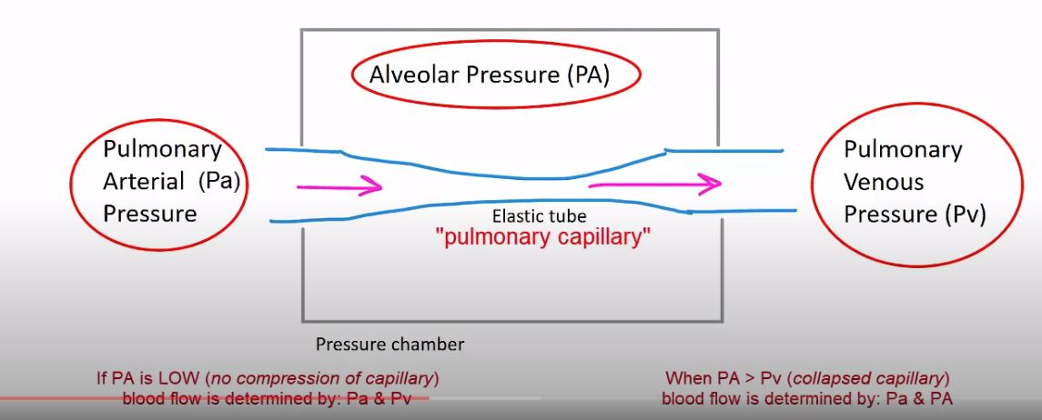
West zones

Slide 76
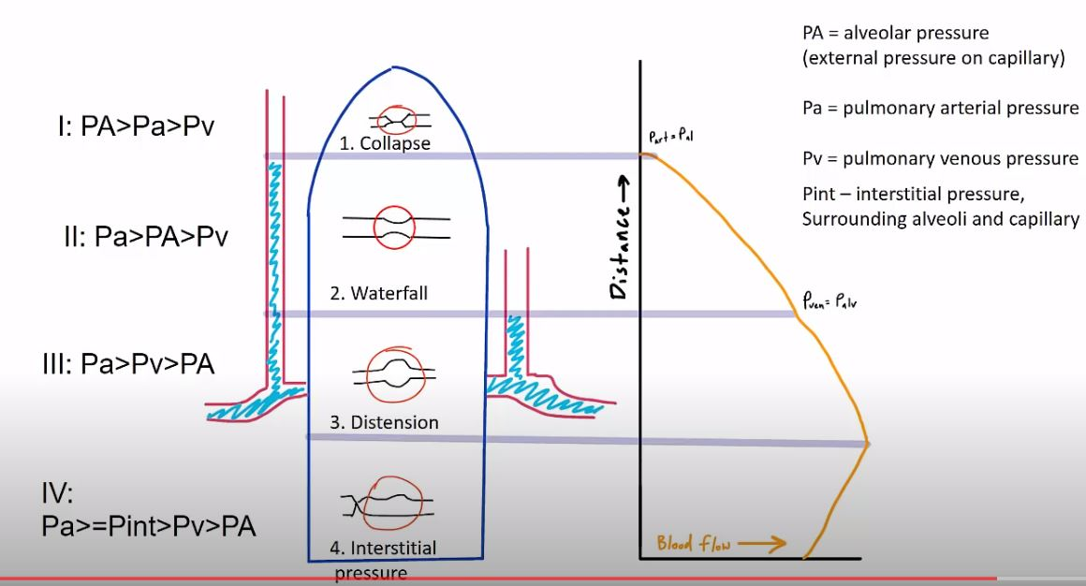
Zone 3 corresponds to a level below the LA level on a 90°
supine patients- the majority of the lung is zone 3
zones 1 and 2 expand in case of mechanical ventilation (increased alveolar
pressure), PEEP, or low LA pressure (hypovolemia)

Slide 77
Mean PCWP greater than diastolic PA (contd…)
  catheter’s being wedged in zone 1 or 2 of the lung - PCWP reflects alveolar pressure rather than capillary pressure and may be larger than PA diastolic pressure; PCWP will have large respiratory swings and will have a smoother appearance - no A or V waves

Slide 78
severe pulmonary hypertension (PH)
  difficult for the catheter to occlude the PA; thus, wedged PA waveform may be a damped PA pressure and may overestimate the true PCWP (hybrid PA-PCWP waveform with arterial characteristics)
  Retrograde transmission of LA pressure is attenuated due to vascular changes - mean PCWP may approximate mean LA pressure, but the waveform is flat and featureless

Slide 79
Over-wedged waveform
  balloon is overinflated or if the PA catheter is positioned too distally, the tip of the catheter may become compressed by the vessel wall
  continuous rise or a continuous fall of PCWP with damping and a lack of distinct A and V waves
  Over-wedging may lead to pulmonary arterial rupture

Slide 81
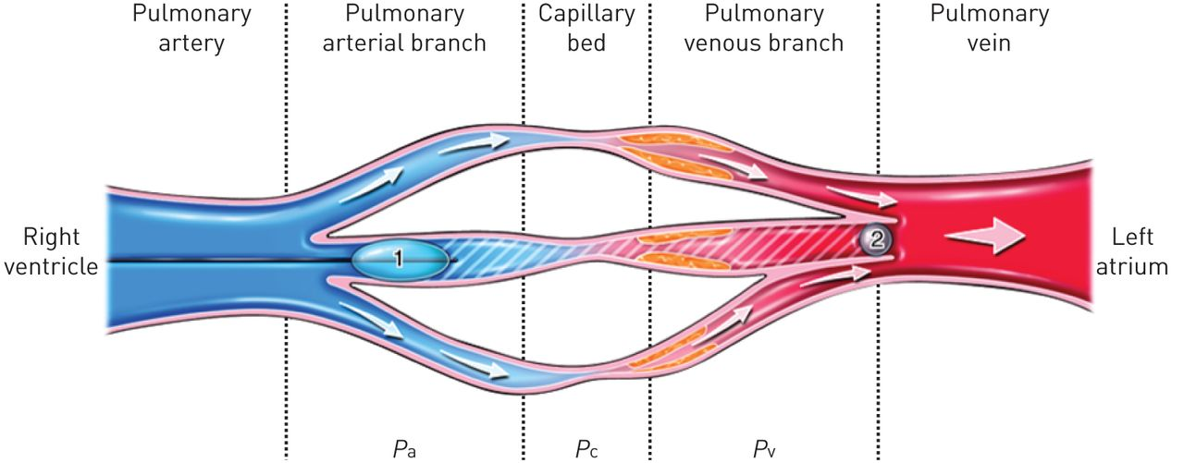
Pul venous obstruction
  Pulmonary veno-occlusive disease or pulmonary venous constriction that occurs with hypoxemia, sepsis or acute lung injury
  pulmonary capillary hydrostatic pressure (Pcap) is elevated whereas LA pressure is normal
  PCWP may (theoretically) represent LA pressure and not Pcap
  But PCWP is elevated – overestimates LA pressure as high surrounding pulmonary pressure compresses the pulmonary capillaries

Slide 82
PCWP utility is limited in ICU setting
  Does not correlate well with LA pressure and tends to overestimate the true LA pressure, often lacking A and V waves
  PCWP may be damped
  Does not reflect LV preload in acute conditions (relatively normal LV preload is associated with a high LA pressure)
  Errors in zeroing and large respiratory swings, particularly in mechanically ventilated patients
PCWP tends to overestimate preload in critically ill patients

Slide 83
PCWP vs PA pressure
  PCWP may simulate PA tracing in case of large V wave, severe pulmonary arterial hypertension(hybrid PCWP-PA), under-wedging
  Keys to differentiate
    V wave peaks after the end of the ECG T wave, whereas, systolic PA pressure peaks before the end of T wave
    diastolic PA pressure, is downsloping, whereas the segment between V waves is horizontal
    PA pressure has a dicrotic notch
    PA pressure is double peaked – transmission of v wave to PA pressure
    Mean PCWP should be equal to diastolic PA pressure or less and less than mean PA pressure

Slide 84
PCWP vs PA

Slide 85
To confirm PCWP vs PA tracing
  balloon deflation and pullback - change in the timing of the pressure tracing and in the height of the mean pressure corresponding to PA pressure
  SpO2 from blood sample from wedged tip –
    PCWP saturation = pulmonary venous saturation (usually >95%), whereas PA saturation = mixed venous saturation
Notes:
2.1 It is, however, difficult to withdraw blood from a wedged Swan catheter.

Slide 86
Abnormalities of PCWP tracing
large V wave (V wave >10 mmHg larger than mean PCWP or a V wave larger than twice the mean PCWP)
  severe acute or decompensated MR
  decompensated LV systolic or diastolic failure with impaired LA compliance
  mitral stenosis
  atrial dysfunction and fibrosis in long-standing diastolic HF, postoperative states or rheumatic involvement of the atrial wall
  AF - V wave becomes the only dominant wave
  ventricular septal defect

Slide 87
V wave, close to 3 times the mean PCWP, suggestive of severe MR
The LVEDP is increased as a result of
MR, but not as much as PCWP
atrial fibrillation, so A waves are not seen
early PCWP-LV gradient related to V wave, but
LV and PCWP equalize soon afterward, indicating
the lack of MS

Slide 88
V wave that is more than 3 times the mean PCWP is very specific for MR
Decompensated LV failure
  High PCWP with high early diastolic gradient between PCWP and LV pressure. PCWP equalizes with diastolic LV pressure in mid diastole. Large trans-mitral E wave on echo.
Impaired LV compliance
  large A wave
  A wave is often larger than V wave in compensated LV dysfunction
  MS before the LA becomes dysfunctional

Slide 89
LA pressure remains
higher than LV pressure
throughout diastole, signifying
moderate or severe MS

Slide 94
In summary
Deep X and deep Y: constrictive pericarditis
Deep X and flat Y (diastolic flow blunting): tamponade, but also sinus tachycardia (mnemonic: Flat Y Tamponade=FYT)
Flat X (systolic flow blunting) and deep Y: severe TR and/or RV failure
Large V wave: severe TR and/or RV failure
Ventricularized RA pressure: severe TR
Large A wave: impaired RV compliance
Equally large A and V waves: ASD

Slide 95
THANK YOU

